Slide 1
CodeSnip
Developer Productivity Tool
Team-13
CSE 210
Nov 6, 2024

Slide 2
Statement Of Purpose
“Our project aims to develop a code snippet manager that addresses the evolving needs of modern developers. Building upon an existing code snippet management extension, our goal is to create a centralized, user-friendly platform that allows developers to efficiently organize, access, reuse and share their code snippets with others, enhancing productivity”
Vision
“To leverage our academic knowledge and innovative thinking to create impactful, practical software solutions that solve real-world problems. As a team of passionate learners, we're focused on improving our skills, working together, and delivering projects that make a tangible difference in both academic and professional contexts”

Slide 3
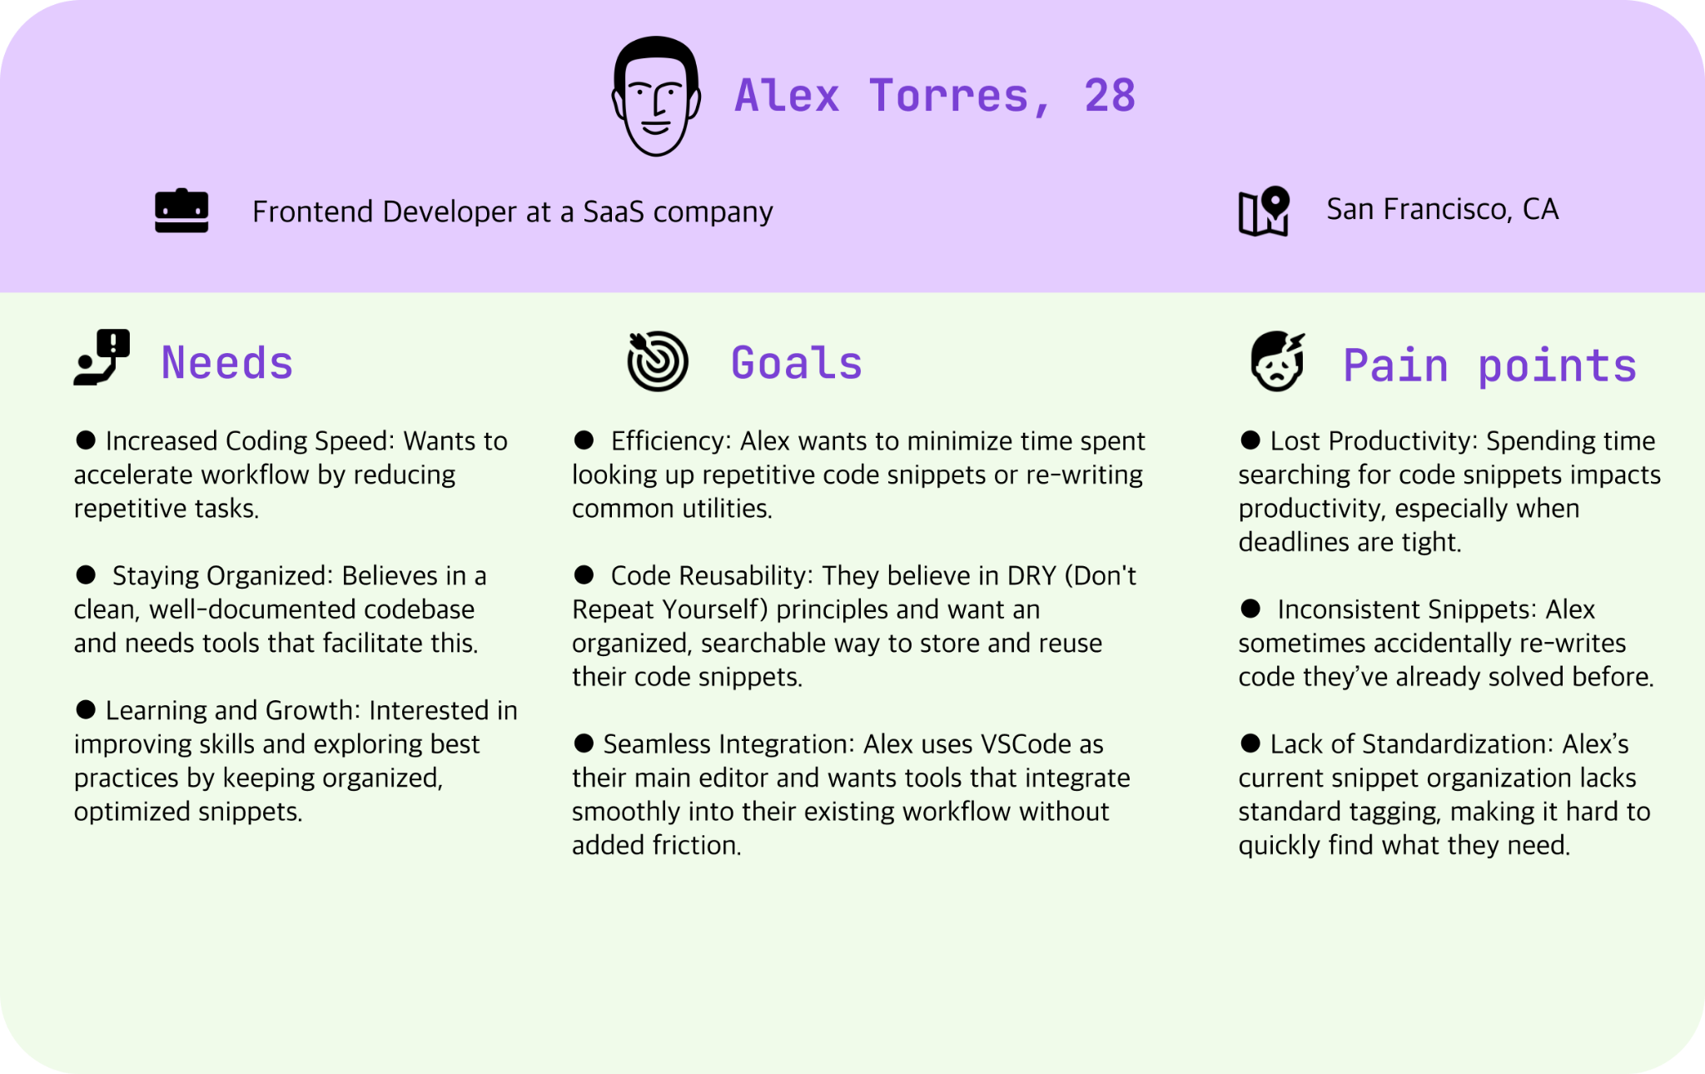
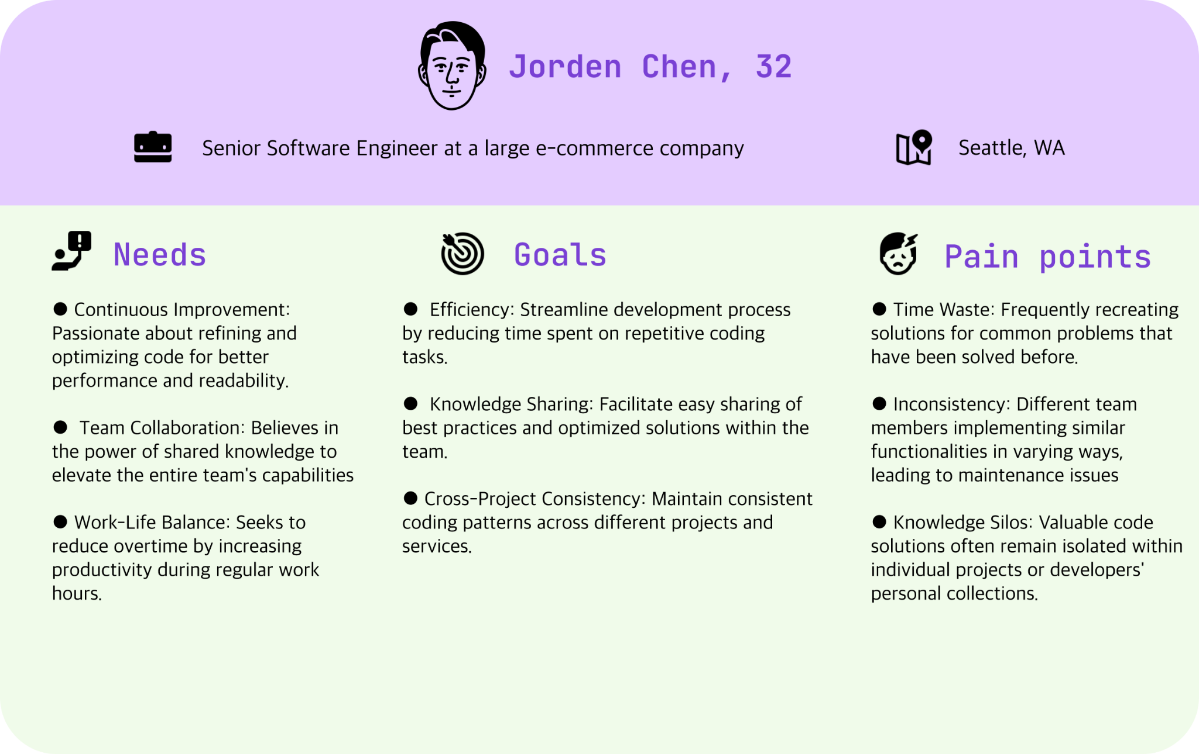
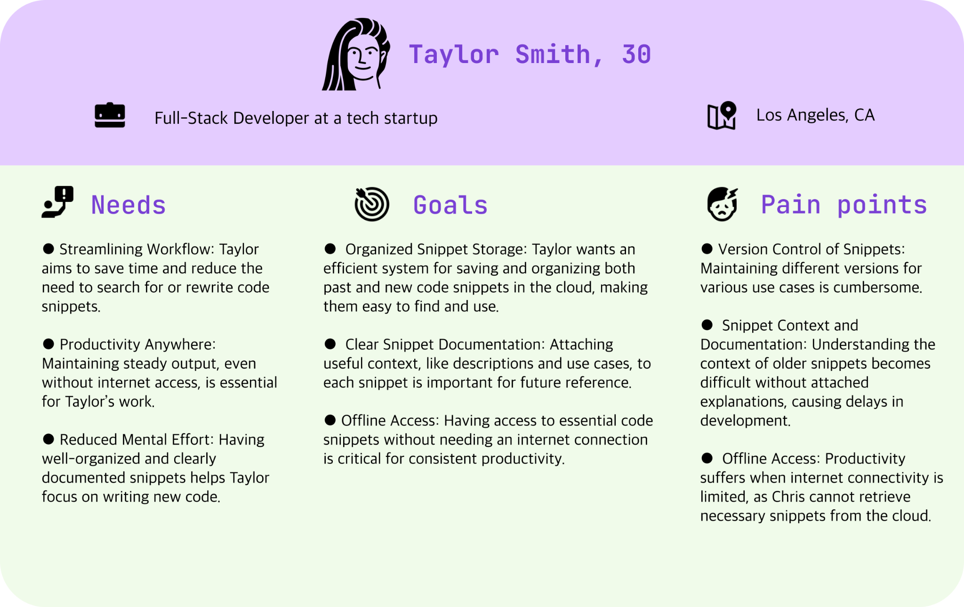
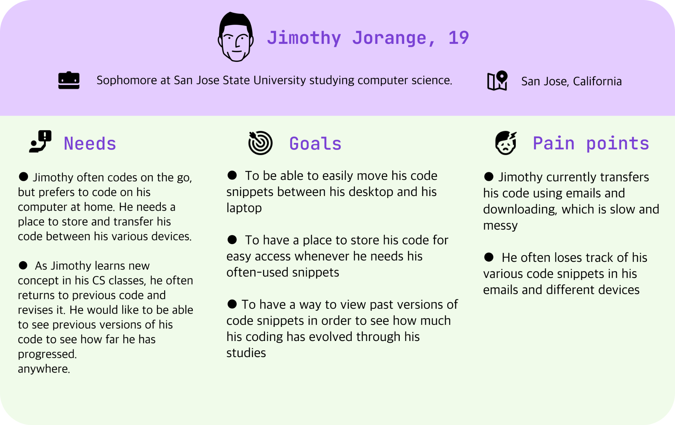
User Personas

Slide 4
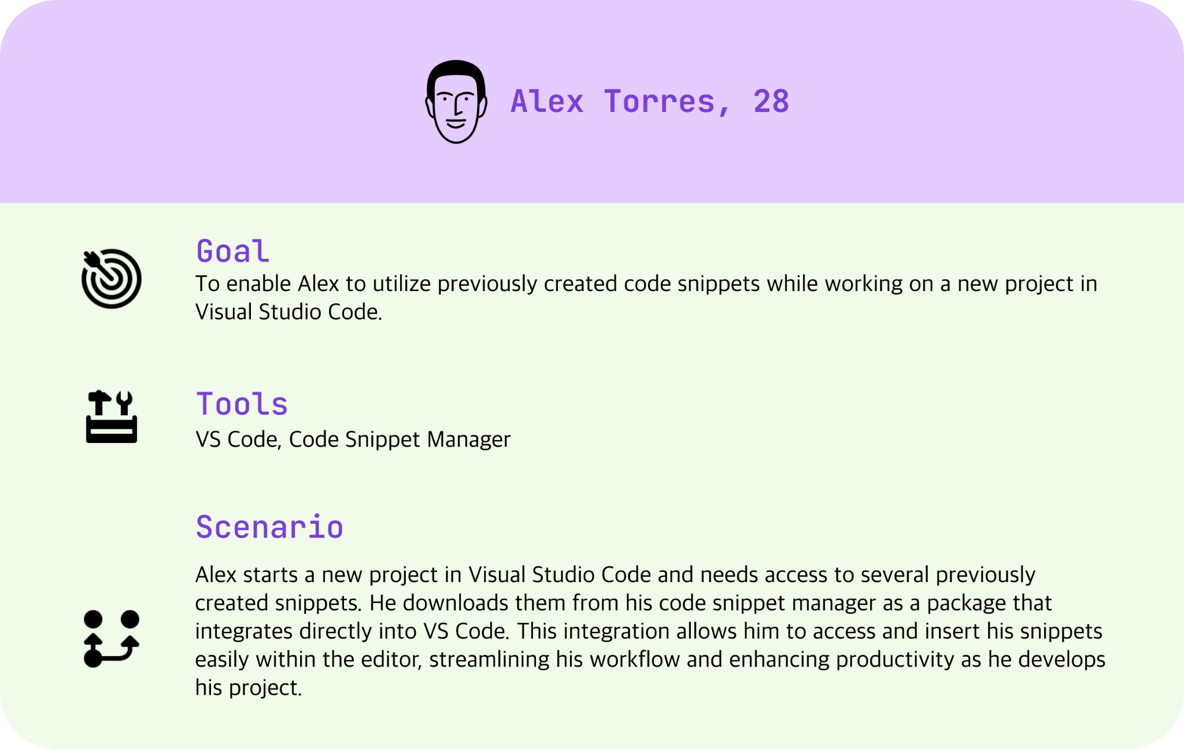
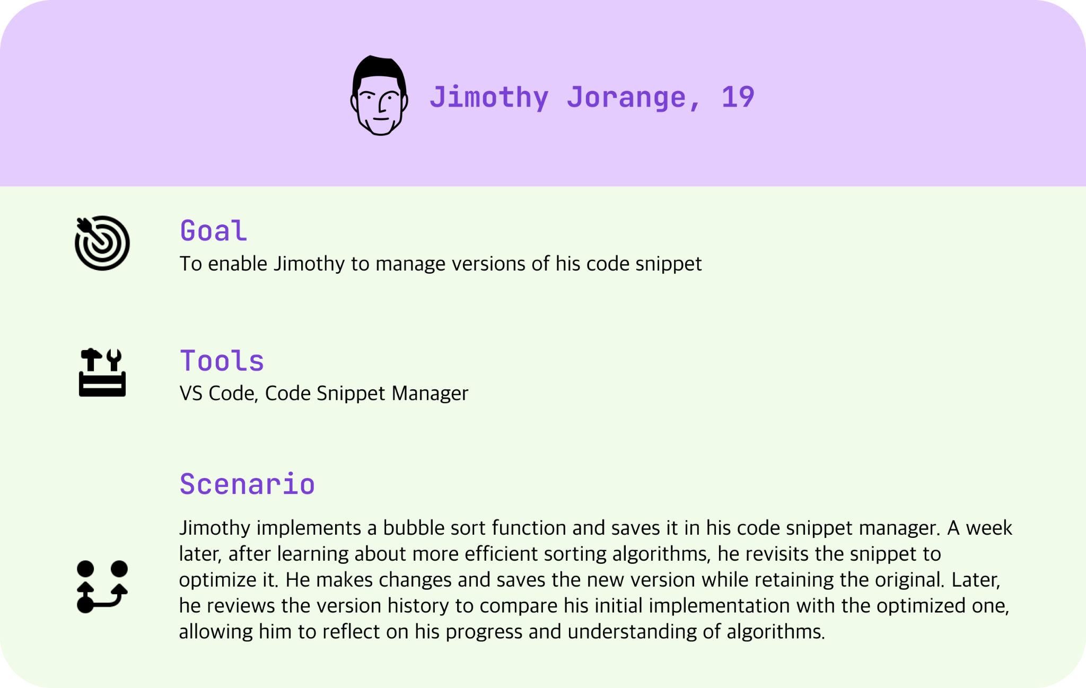
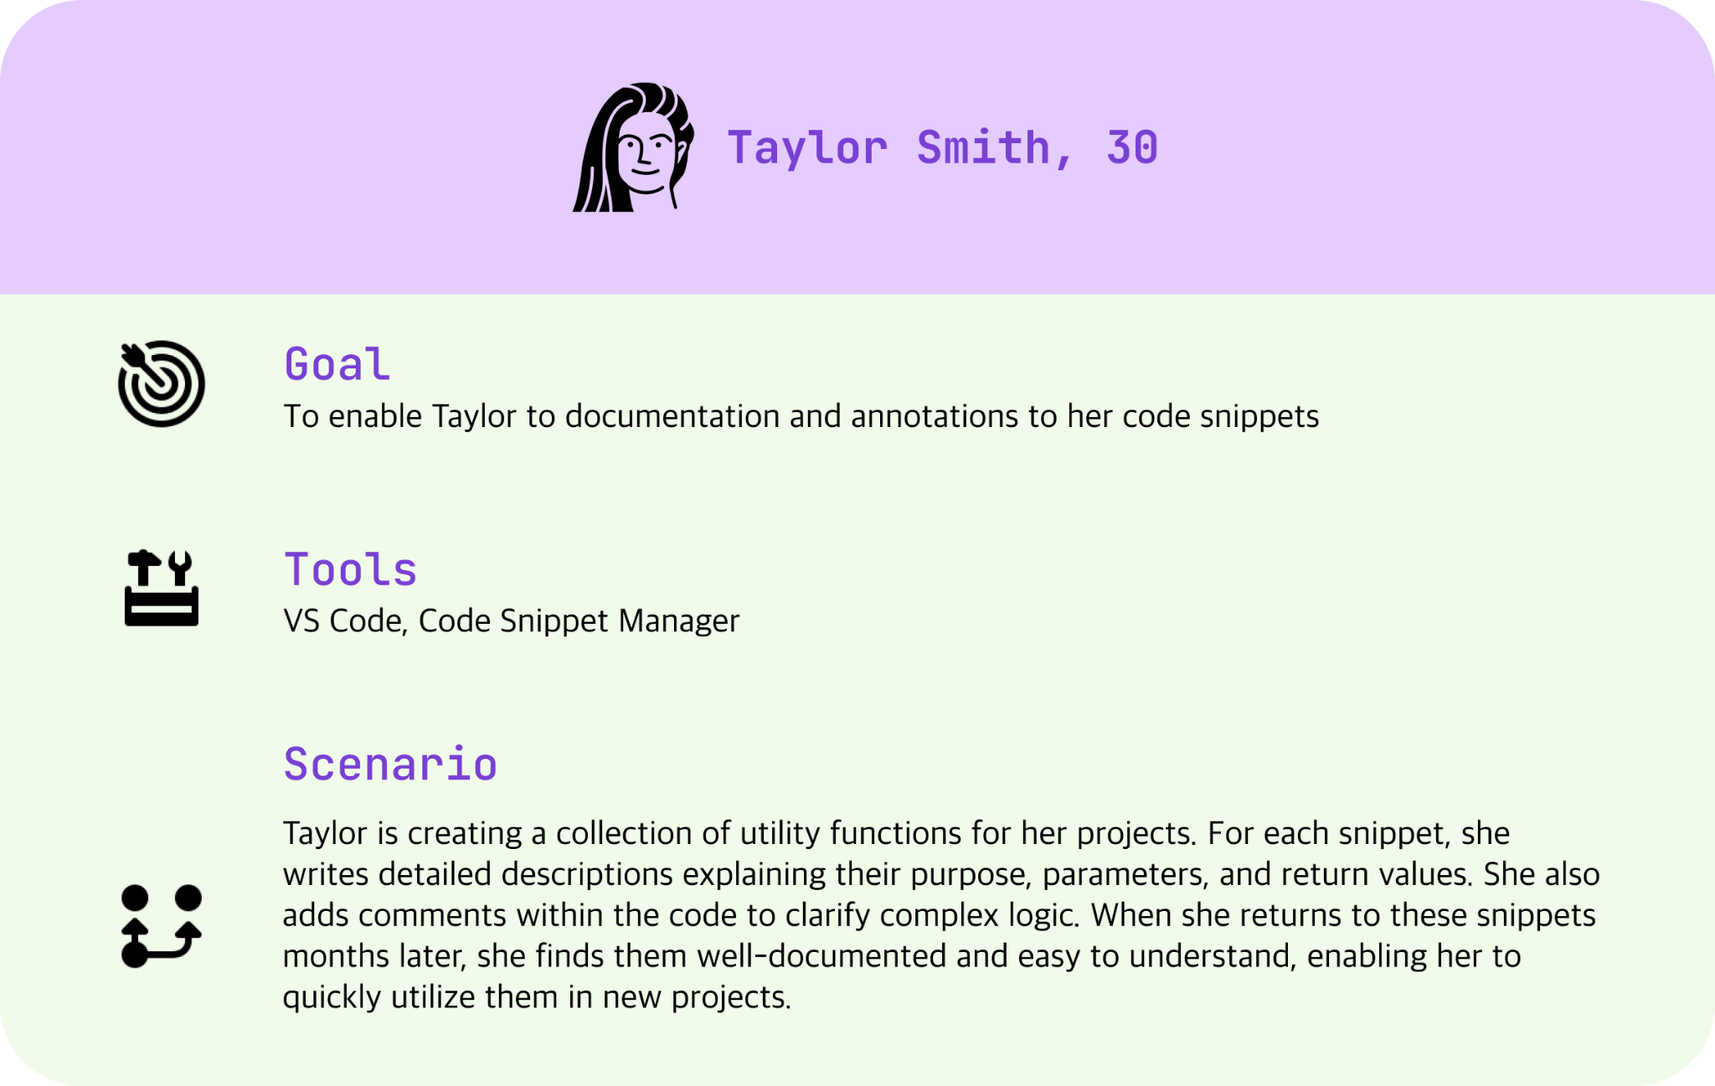
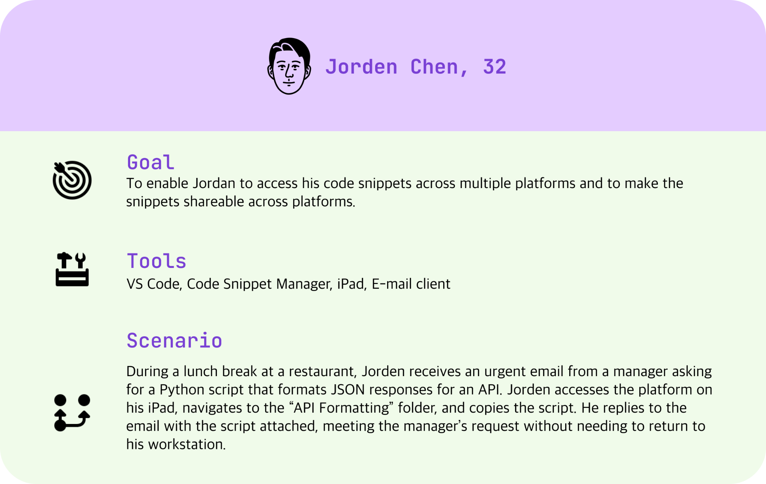
User Scenarios

Slide 5
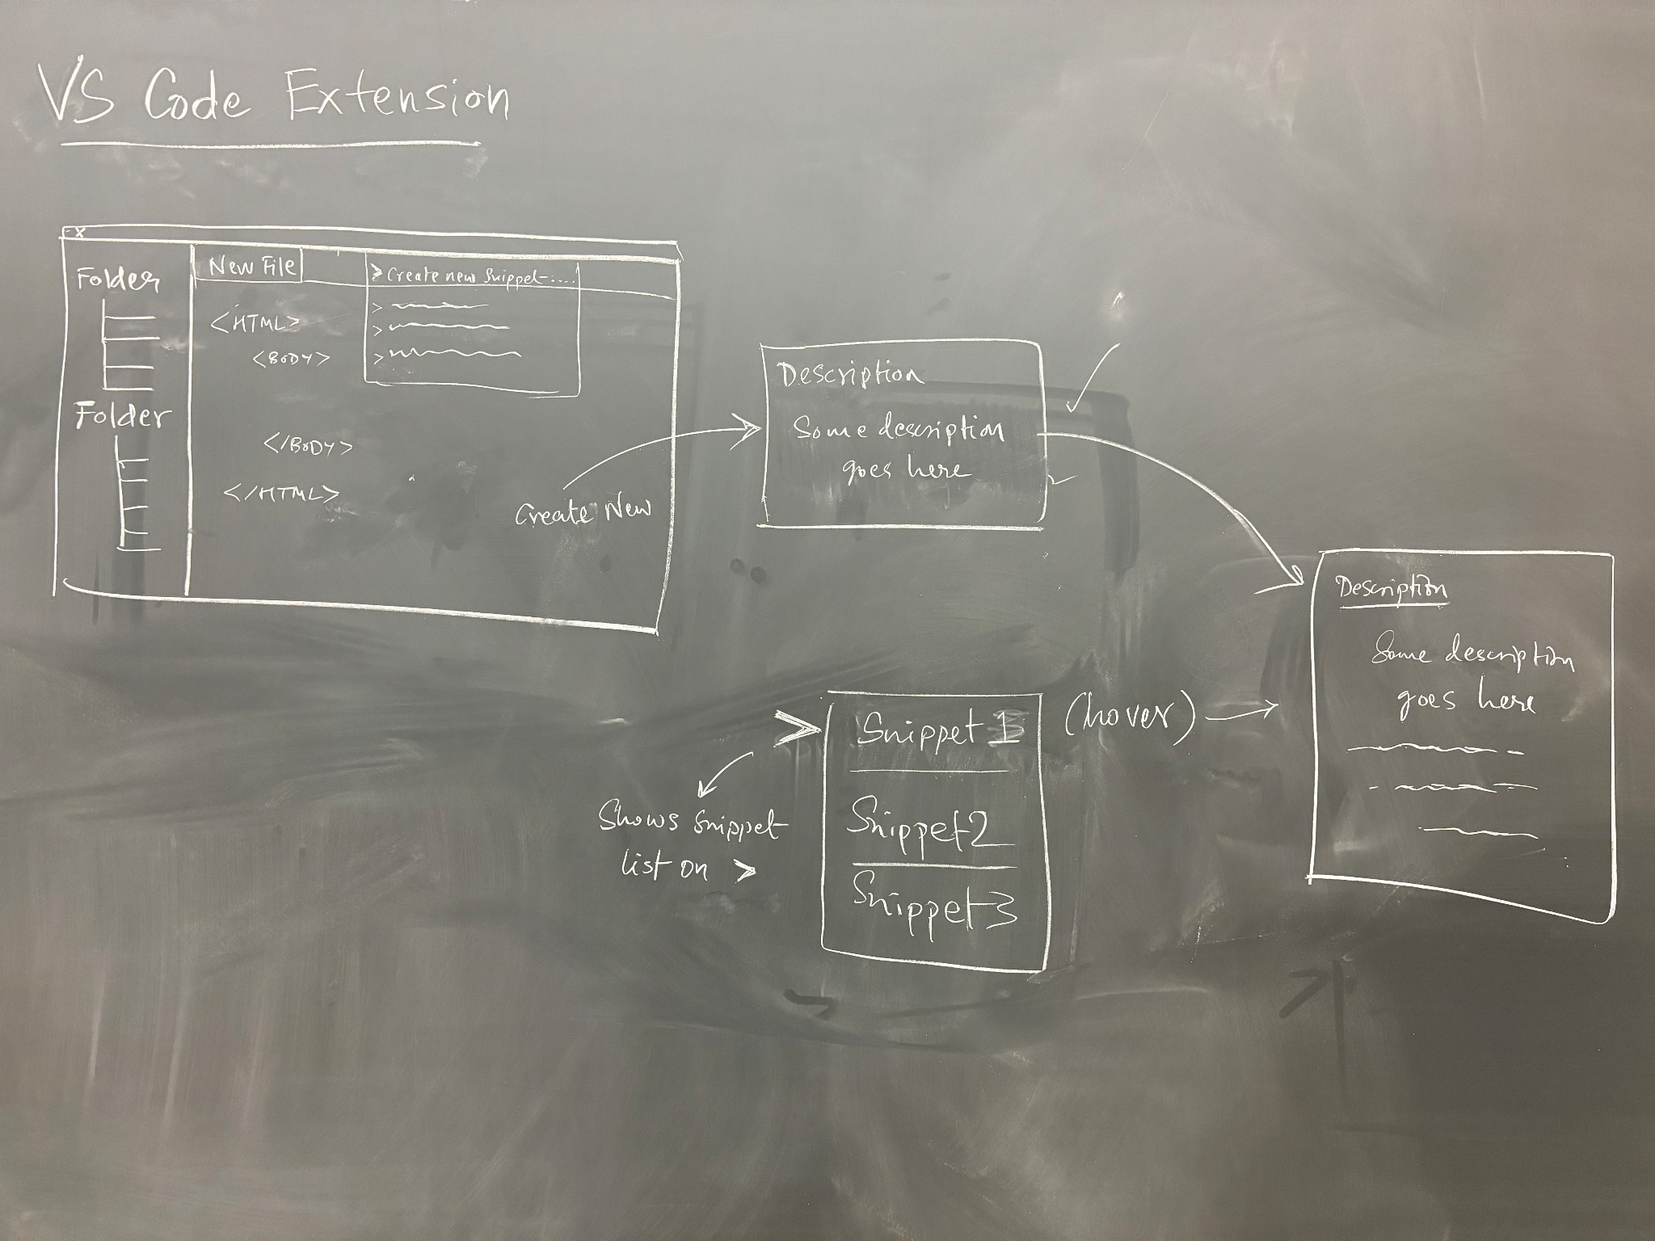
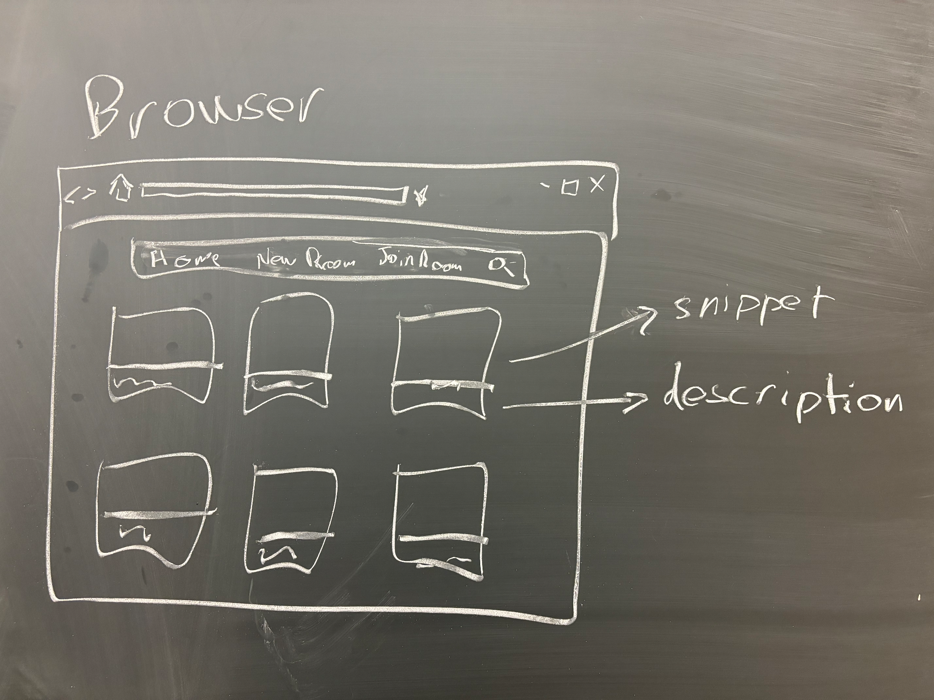
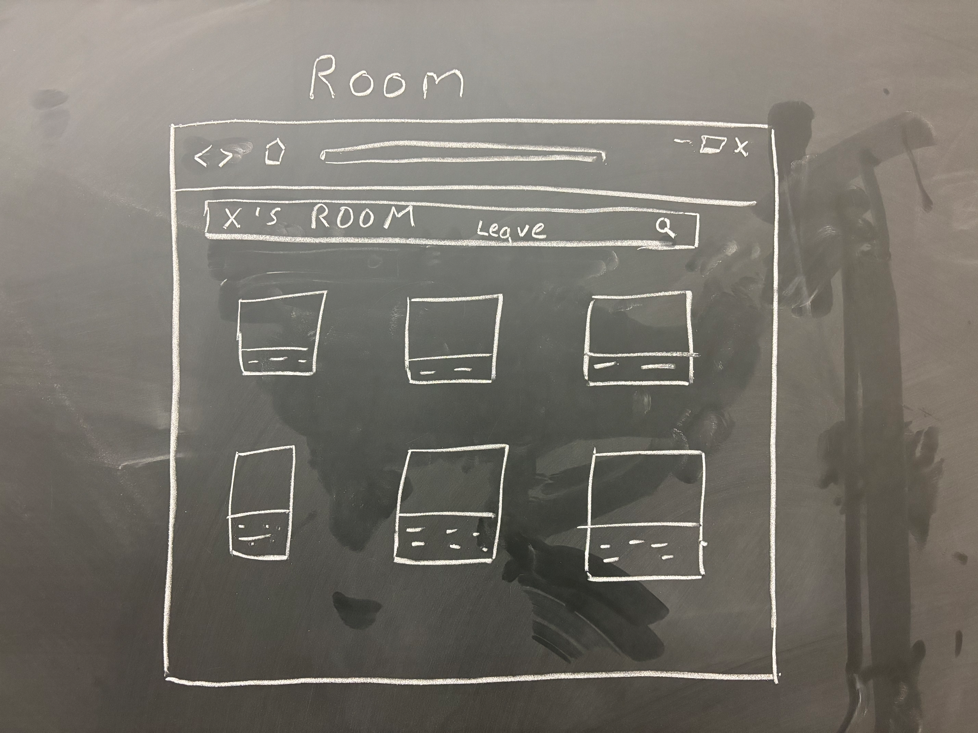
Fat-Marker Sketches
Feature addition to VSCode extension
A local web browser application to visualize the snippets
A web application allowing users to share snippets

Slide 6
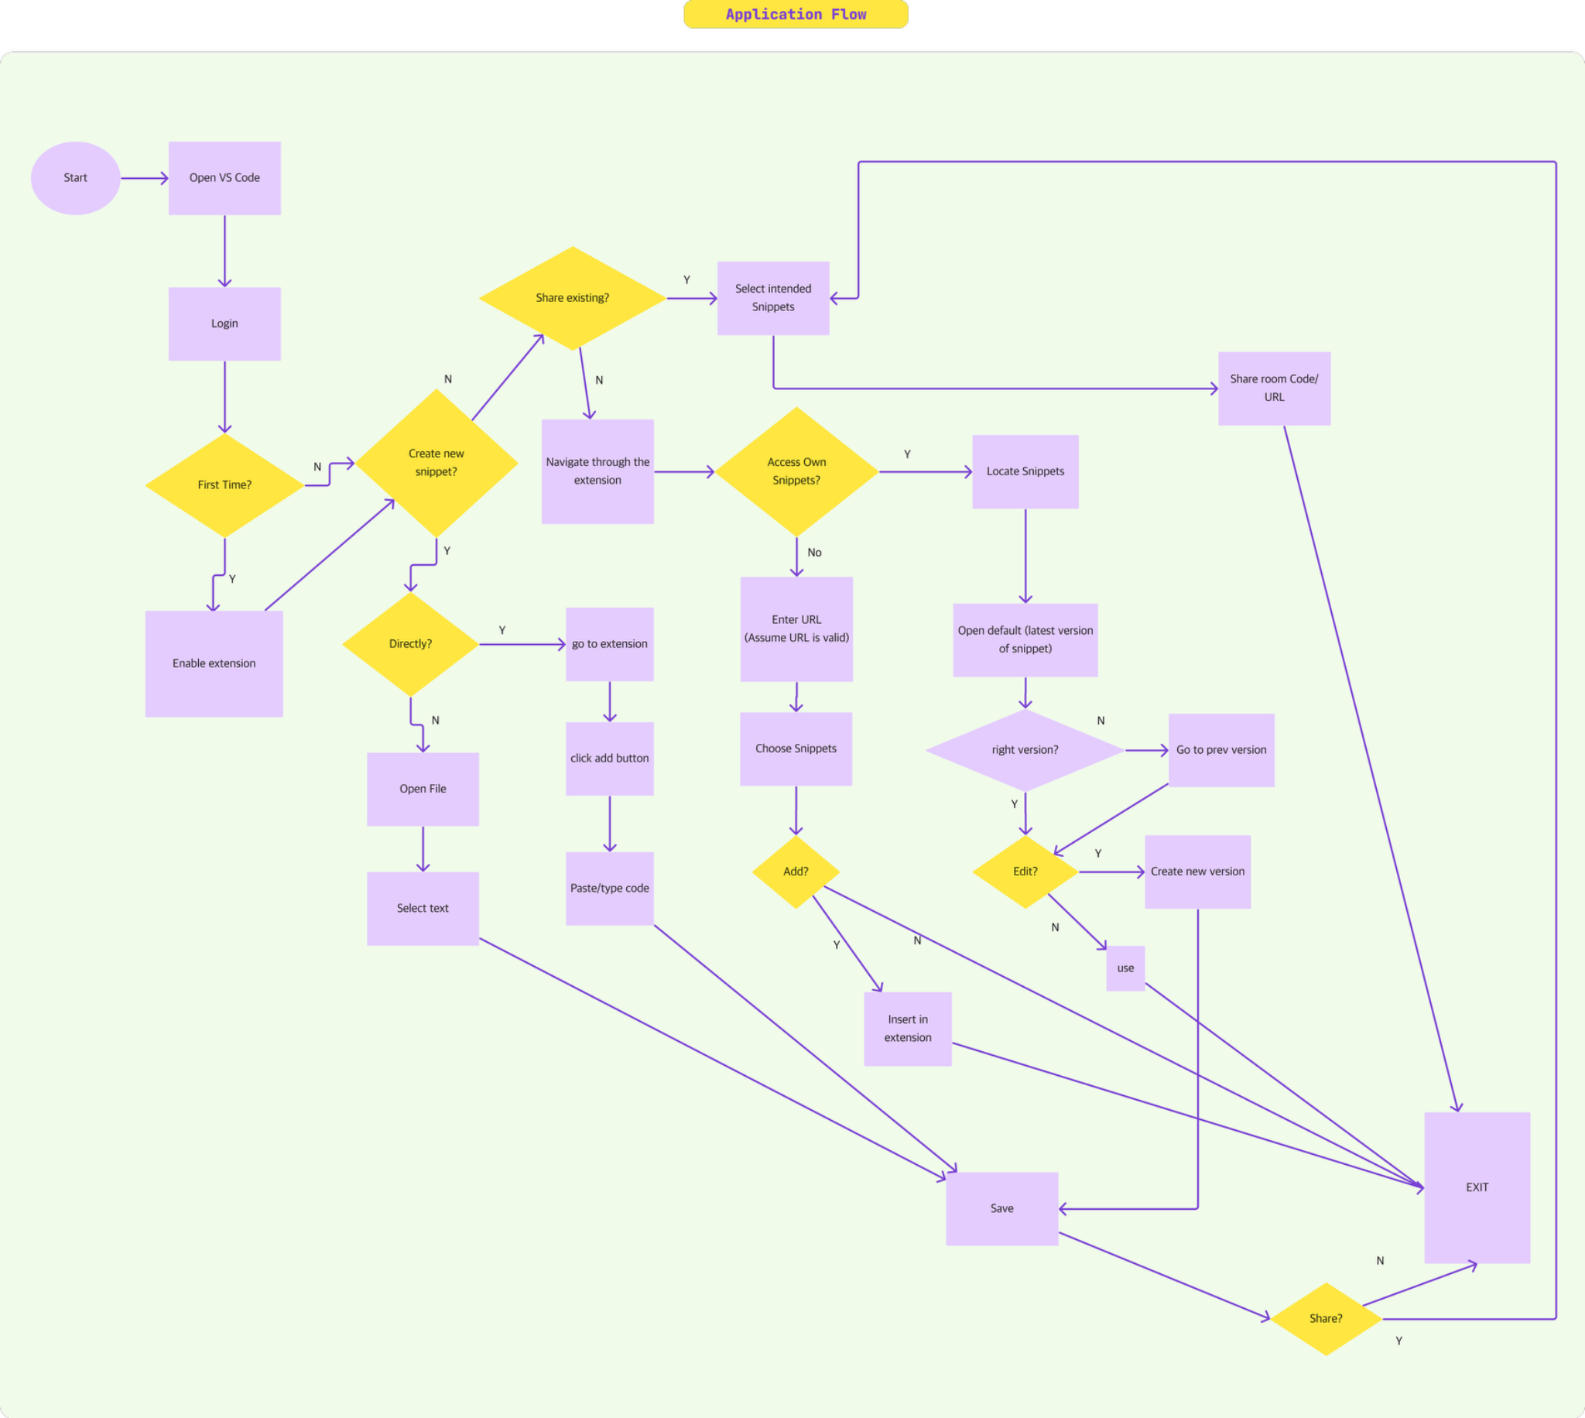
Workflow Diagram

Slide 7
Risks
Rabbit Holes
Team hasn't worked with VS Code extensions before
Uncertainty in fully understanding the existing codebase
Complexity and Challenges in implementing snippet sharing
Proposed features must be compatible with VS Code extension capabilities
Limited Extendibility of existing codebase
Need for Cross-Device Compatibility
Overemphasis on understanding every detail of the existing codebase
Worrying about scaling infrastructure and databases before proving that the basic features work
Focusing on sharing details (permissions, etc.) before basic functionality
Prioritizing UX over core behavior early in development.
Authentication via OAuth

Slide 8
Thank you!

